Slide 1
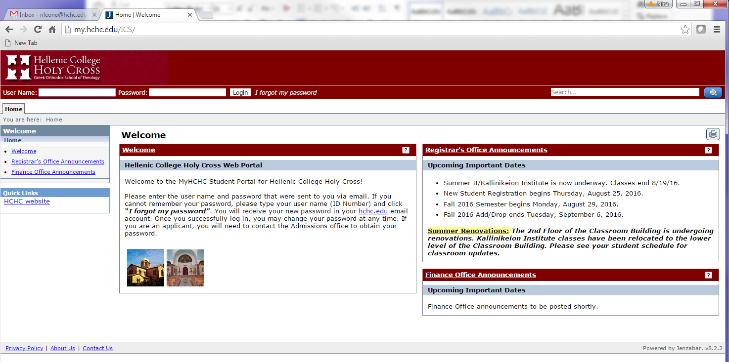
Faculty/advisor Portal training guide
url: My.hchc.edu/ics

Slide 2
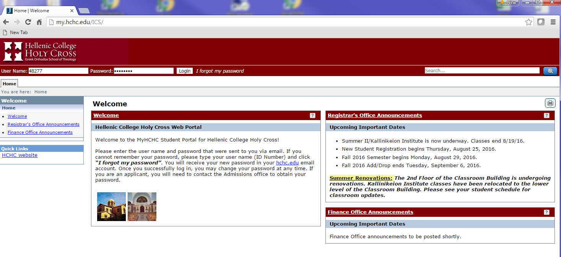
Enter your user name and password and hit the login button if you forget your password, you can enter your user name and click on the “I forgot my password” and your password will be reset and an email will be sent to your HCHC email account.
En

Slide 3
To change your password, click on the “Personal Info” link and that is where you will manage your account information and change your password

Slide 4
Click on the Password tab and here is where you will enter your current password and then your new password and confirm your new password. In this area you may also view all your current information that is entered in the Jenzabar system.

Slide 5
The Resources tab will have all resources needed for the students and faculty to have to help students succeed and meet their needs and goals towards their degree.

Slide 6
If you are a faculty and an advisor, you will have this faculty and advisors tab. You will also see faculty home page on the left and a advisor home page if you are not an advisor, you will not see the advisor home page on the left side

Slide 7
In the My courses portlet, you will have multiply choices under the drop down menu in the “Go directly to “ area Course Details, class list, grade entry and text book Course Details – you will see all information on your course, the schedule, how many enrolled in your class, dates and times of the class and location.

Slide 8
Class List – you will see all enrolled students in your class. Be able to email all students in your class. Or Export out the entire class list into an excel spreadsheet.

Slide 9
Grade entry – when online final grade entry is opened by the registrar, you will be able to enter the students final grade online through this choice or the Grade Entry portlet.

Slide 10
Textbook Entry – here is where faculty can add the textbook of their class so the student will be able to see what textbook they need to purchase for their class.

Slide 11
This is the Grade Entry portlet – when online grading is turned on by the registrar, there will be a set begin date and end date, when the begin date opens, you will see under the final grade field, an open field that will have a drop down menu with grades to choose from. Here is where you will enter the students final grade for your class.

Slide 12
This is the course search portlet where any faculty or advisor can search on all courses taught at HCHC during any term. You can see the course code, course name, faculty , how many seats available, the schedule, credits and the begin and end dates.

Slide 13
This in the Room Schedules portlet that will show you any and all building on campus and will show you all courses that are booked in those buildings with room information. Choose the Term, Choose Main Campus, All Buildings, All Rooms and hit “Search”

Slide 14
This is the results you will see when you hit “search” in the Room schedules portlet

Slide 15
If you are also an advisor, you will have access to the “advisor home” page and will have these additional portlets. You will be able to search for all your active advisees. Choose “All”, and hit “Search”

Slide 16
Your list of all active advisees will appear. You will be able to email your advisees either individually or all at once. Under the “Needs to Register?” column, there will be a field that will have choices to clear a student once you see them after you have advised them. This function has not been turned on yet. When it does, you will be notified.

Slide 17
When you click on one of your advisees in the list, you will get the advisee details and in this window, you will have more functions so you can advise your student. You will be able to pull up their Academic History, their grade report, their transcript and also their degree audit.

Slide 18
If you choose the “Degree Audit”, you will see all the students academic information and if you click on the “My Graduation Report pdf”, the audit report will open in PDF format

Slide 19
Here is a copy of the Graduation audit report to see what has been met and what is still required on the student.

Slide 20
This is the function “Course Needs” It will show you which courses are still needed to meet the students degree.

Slide 21
This is the result of the report – My advising Worksheet.

Slide 22
The My Pages tab is for your own personal use. You can use this tab for any of your own bookmarks, booking appointments with students. Any appointment on this calendar will only show on this calendar and the students calendar. You can create your own groups and email to your own student groups.

